Slide 1
Physical Fitness
&
Body Posture

Slide 2
What is physical fitness?
Physical fitness refers to the ability of the body to perform daily activities with optimal performance, endurance, and strength while managing fatigue and reducing the risk of injury or disease. It encompasses a range of components that contribute to overall health and well-being. Here are the primary components of physical fitness

Slide 3
Components of Physical Fitness
Cardiovascular Endurance:-The ability of the heart, lungs, and blood vessels to deliver oxygen to the body during sustained physical activity. Activities like running, cycling, and swimming improve cardiovascular endurance.
Muscular Strength:- The maximum amount of force that a muscle or group of muscles can exert against resistance. Weightlifting and resistance training are common ways to enhance muscular strength.
Muscular Endurance:- The ability of muscles to sustain repeated contractions or continue applying force against a fixed object. Activities such as rowing, cycling, and bodyweight exercises (e.g., push-ups) help build muscular endurance.
Flexibility:- The range of motion available at a joint. Flexibility can be improved through activities like stretching, yoga, and Pilates.
Body Composition:- The relative proportions of muscle, fat, bone, and other vital parts of the body. Healthy body composition typically involves a higher ratio of lean mass to fat mass, and it can be influenced by diet and exercise.

Slide 4
Balance:- The ability to maintain the body's position, whether moving or stationary. Balance exercises often involve activities that improve core strength and stability, such as tai chi and balance drills.
Coordination:- The ability to use different parts of the body together smoothly and efficiently. Coordination can be improved through activities that require precise movements, like playing sports or dancing.
Speed:- The ability to move quickly across the ground or move limbs rapidly to grab or throw. Sprinting and agility drills help enhance speed.
Agility:- The ability to quickly change direction or position of the body efficiently. Agility training often includes exercises like shuttle runs and obstacle courses.
Power:- The ability to exert a maximal amount of force in the shortest possible time. Power is a combination of strength and speed and can be developed through activities like ply metrics and explosive weight training.

Slide 5
Importance of Physical Fitness
Physical Health Benefits:-
Improved Physical Health: Regular physical activity helps maintain a healthy weight, reduces the risk of chronic diseases such as obesity, diabetes, and cardiovascular diseases, and promotes overall physical health.
Enhanced Immune System: Exercise strengthens the immune system, helping children fend off illnesses more effectively.
Mental Health Benefits:-
Stress Reduction: Physical activity is known to reduce stress and anxiety levels. Exercise stimulates the production of endorphins, which are natural mood lifters.
Improved Mood and Self-Esteem: Regular physical activity can enhance students' mood and boost their self-esteem and confidence.
Cognitive Benefits:-
Enhanced Cognitive Function: Physical fitness is linked to improved cognitive functions such as better concentration, enhanced memory, and quicker learning.
Better Academic Performance: Studies show that physically active students tend to have better grades and academic performance.

Slide 6
Importance of Physical Fitness
Social Benefits:-
Improved Social Skills: Physical activities, especially team sports, help students develop social skills, such as teamwork, cooperation, and communication.
Positive Peer Relationships: Participating in physical activities provides opportunities for students to form positive relationships and friendships.
Long-term Benefits:-
Healthy Lifestyle Habits: Establishing the habit of regular physical activity during school years sets the foundation for maintaining a healthy lifestyle in adulthood.
Prevention of Lifestyle Diseases: Early engagement in physical fitness reduces the risk of developing lifestyle-related diseases later in life.
Educational Benefits:-
Discipline and Goal Setting: Sports and physical activities teach students the importance of discipline, setting goals, and working hard to achieve them.
Improved Behavior and Attendance: Physical fitness programs have been linked to improved behavior and attendance in schools, contributing to a better learning environment.

Slide 7
Recommendations for Schools
Incorporate Regular Physical Education Classes: Schools should ensure that students have regular physical education classes that are engaging and inclusive.
Promote a Variety of Activities: Offering a wide range of physical activities, from traditional sports to yoga and dance, can cater to different interests and abilities.
Encourage Active Breaks: Integrating short physical activity breaks during academic lessons can help maintain students' focus and energy levels.
Create a Supportive Environment: Schools should create a supportive environment that encourages all students to participate in physical activities, regardless of their skill level.
Overall, emphasizing physical fitness in schools is essential for fostering the holistic development of students, ensuring they grow up to be healthy, well-rounded individuals

Slide 8
Achieving Physical Fitness
Regular Exercise: Engaging in a variety of physical activities that target different components of fitness.
Healthy Diet: Consuming a balanced diet that provides the necessary nutrients to support physical activity and overall health.
Rest and Recovery: Ensuring adequate rest and recovery to allow the body to repair and strengthen.
Consistency: Making physical activity a regular part of daily routine for sustained benefits.
In summary, physical fitness is a multifaceted state of health and well-being, essential for performing daily activities efficiently, maintaining health, and enhancing quality of life.

Slide 9
Body Posture
. Importance of Body Posture:
Physical Health Benefits:
1. Reduced Risk of Pain and Injury.
2. Improved Breathing.
3.Enhanced Digestion.
.Mental Health Benefits:
1.Boosted Confidence and Mood.
2.Improved Focus and Concentration.
Functional Benefits:
1.Better Balance and Coordination.
2.Enhanced Athletic Performance.
.Long-term Benefits:
1.Prevention of Chronic Conditions.
2.Aging Gracefully.

Slide 10
How to Improve Body Posture
Practical Tips for Maintaining Good Posture
Ergonomic Adjustments:
  Workstation Setup: Ensure your workstation is ergonomically set up with the monitor at eye level, feet flat on the floor, and elbows at a 90-degree angle.
  Supportive Chair: Use a chair that supports the natural curve of your spine and allows for feet to rest flat on the ground.
Regular Movement:
  Frequent Breaks: Take regular breaks to stand, stretch, and move around, especially if you have a sedentary job.
  Exercise: Engage in exercises that strengthen core muscles, such as yoga, pilates, and strength training.
Mindfulness and Awareness:
  Posture Checks: Regularly check and correct your posture throughout the day, whether you’re sitting, standing, or walking.
  Mindful Practices: Incorporate mindful practices like yoga and tai chi that emphasize body awareness and alignment.

Slide 11
What is Good Posture:
Good posture refers to the correct alignment of body parts supported by the right amount of muscle tension against gravity. It involves holding the body in positions where the least strain is placed on supporting muscles and ligaments during movement and weight-bearing activities. Good posture helps to maintain balance, reduce the risk of injury or strain on muscles and joints, and contribute to a more confident appearance.
What is Bad Posture:
Bad posture refers to the improper alignment of body parts that places undue stress on muscles, ligaments, and joints. It typically involves slouching or hunching over, causing the spine to be out of its natural alignment. This can lead to various musculoskeletal issues such as back and neck pain, headaches, and reduced flexibility. Bad posture may result from habits like sitting for prolonged periods, improper ergonomics, or muscle weakness. Addressing bad posture involves awareness, corrective exercises, and ergonomic adjustments to improve alignment and reduce strain on the body.

Slide 12
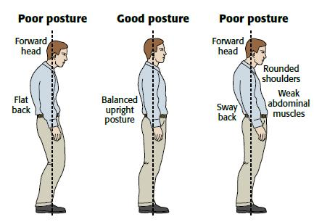
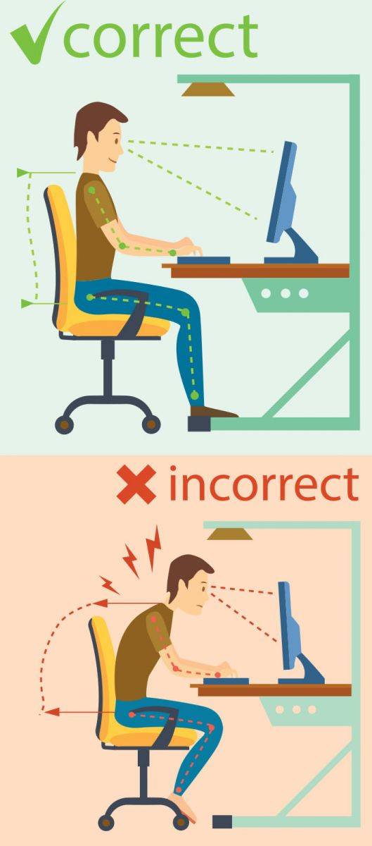

Slide 13
Conclusion
In summary, maintaining good posture is essential for physical health, mental well-being, functional performance, and long-term quality of life. By adopting proper posture habits, individuals can prevent pain, improve physiological functions, and enhance overall well-being.

